Slide 1
DIC (Malaysia) Sdn Bhd
Power BI, Power Query and Excel Dashboard with VBA for Manager
Trainer: Arman Rasouli
Date: 18 – 19 December 2025
Time: 9.00am – 5.00pm

Slide 2



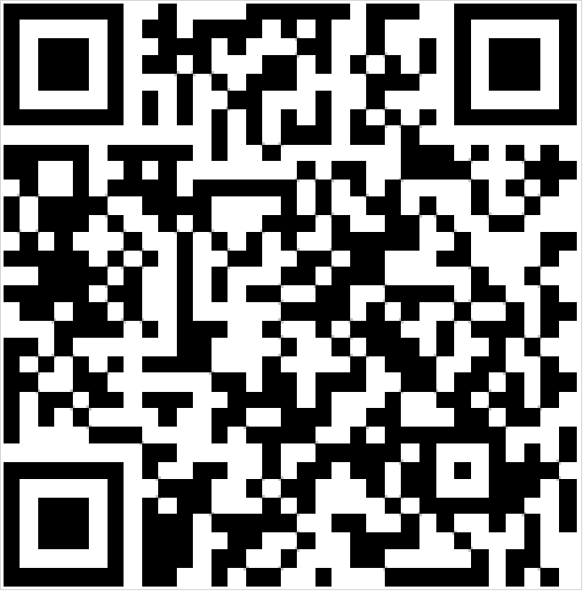

PEOPLEAPS APP DOWNLOAD
PEOPLEAPS MOBILE APP INSTALLATION
SCAN ME TO DOWNLOAD THE APP

Slide 3

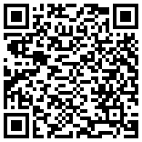
PEOPLEAPS CHECK-IN
Company Domain: “pgtraining”
Username: [your company email]
Password: Abcd1234**
DAY 1 – 18 DECEMBER 2025
CHECK-IN AND PRE-ASSESSMENT

Slide 4
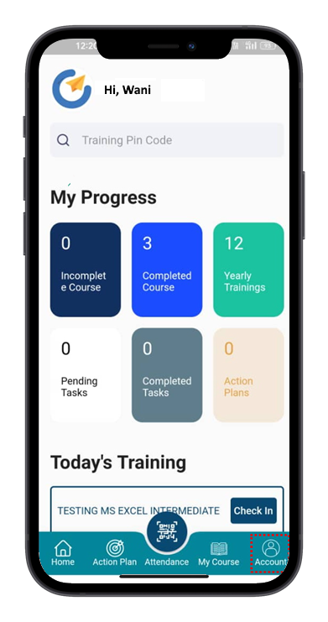
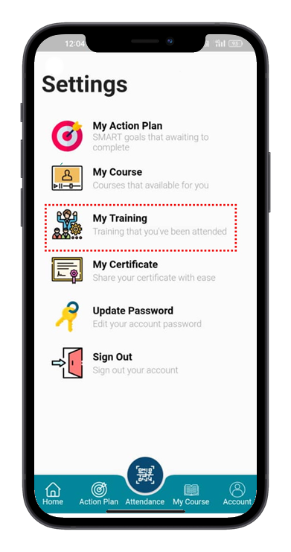
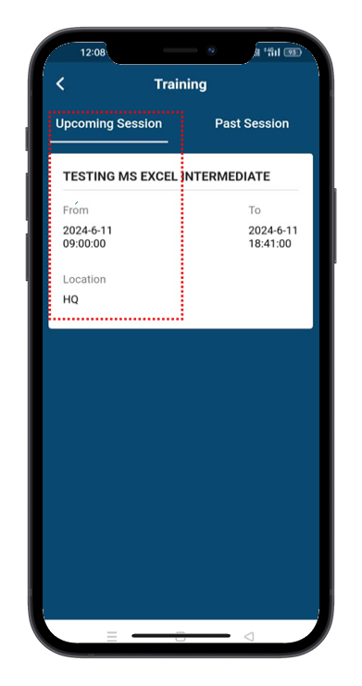
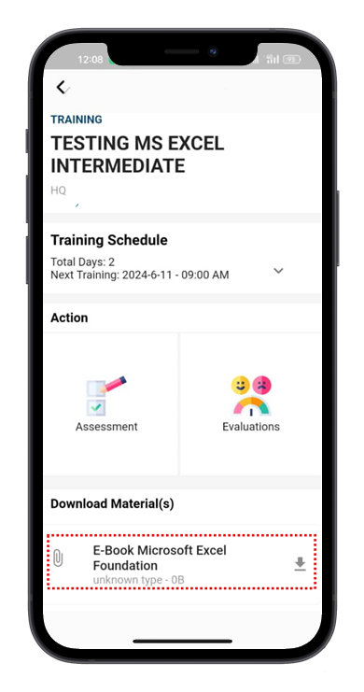
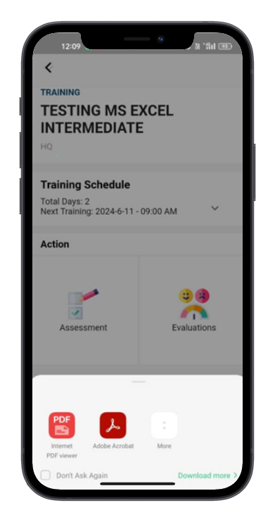

virtual link from the host for our online participants.
E-manual
Download E-Materials
STEP 1
STEP 2
STEP 3
STEP 4
STEP 5
Click “Account”
Click “My training”
Click the training for “Upcoming Session”
Click “Download Materials”
Open the file and save the materials

Slide 5
PROGRAM UPDATE
TENTATIVE PROGRAM RUNDOWN
Time | 18 December 2025 | 19 December 2025
8.30 AM – 9.00 AM | Registration via PEOPLEAPS Check in attendance Pre-Assessment | Check in attendance
9.00 AM | Opening Introduction Class start | Class start
10.30 AM – 10.45 AM | Morning Tea Break | Morning Tea Break
1.00 PM – 2.00 PM | LUNCH | LUNCH
3.30 PM – 3.45PM | Afternoon Tea Break | Afternoon Tea Break
5.00 PM | Check out | Post Assessment Evaluation Check out Group Photo

Slide 6
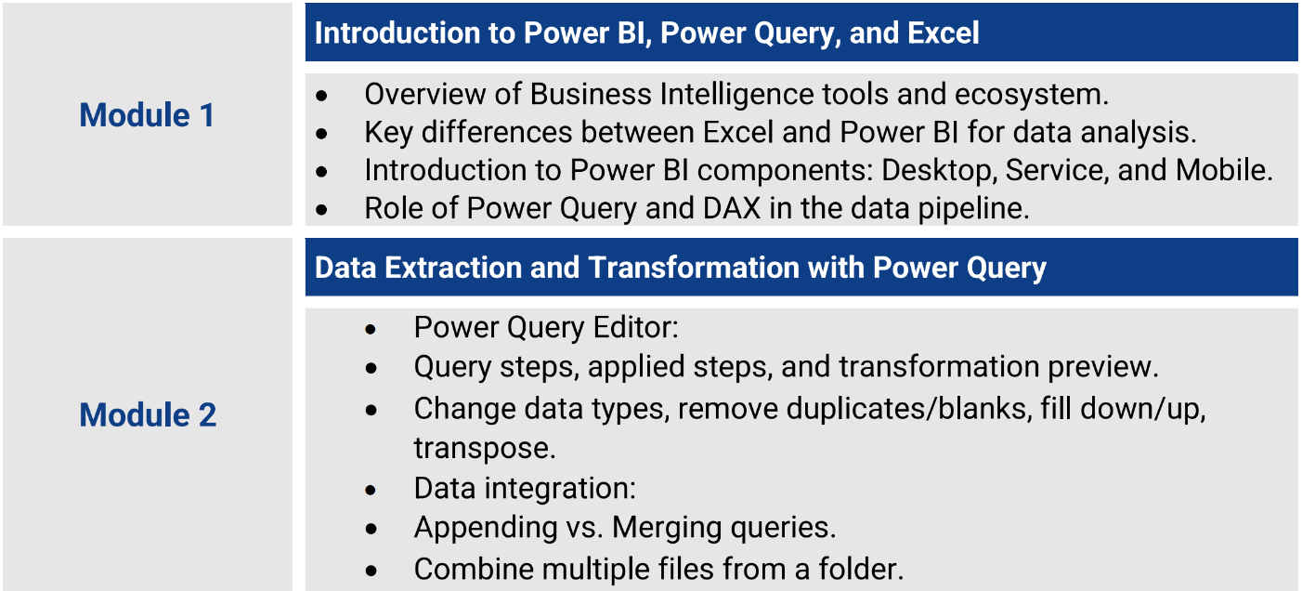
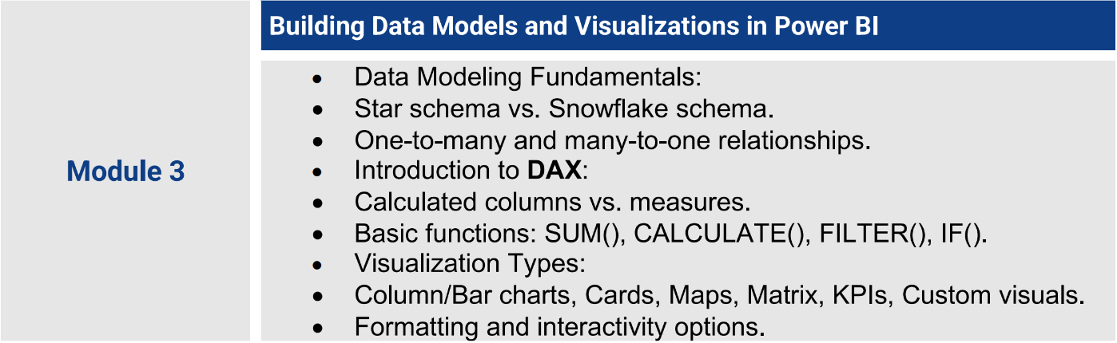
COURSE OUTLINE

Slide 7
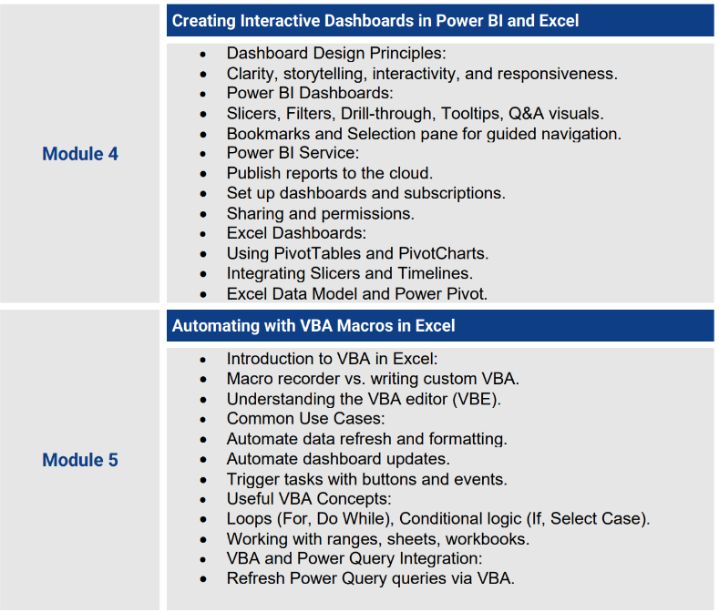
COURSE OUTLINE

Slide 8

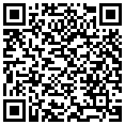

DAY 1 – 18 DECEMBER 2025
CHECK-OUT

Slide 9
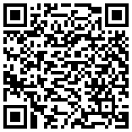

DAY 2 – 19 DECEMBER 2025
CHECK-IN

Slide 10

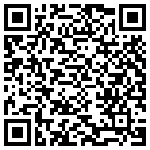
EVALUATION & CHECK-OUT
Company Domain: “pgtraining”
Username: [your company email]
Password: Abcd1234**
DAY 2- 19 DECEMBER 2025
POST-ASSESSMENT, EVALUATION AND CHECK-OUT

Slide 11




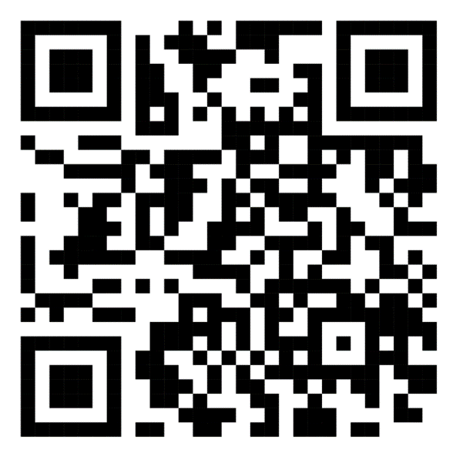

and email to us
trainer@peoplelogy.com

